Slide 1

INNOVATIVE APPROACHES FOR MULTICLASS IDENTIFICATION OF PADDY DISEASES THROUGH ENHANCED FEATURE TRANSFORMATION
PRESENTED BY :- Y. HARSHA SUMANTH REDDY - 125015167 - IT
Y. KIRAN KUMAR REDDY - 125014027 - ICT
N. SUDEENDRA - 125003465 - CSE
GUIDED BY :- Ms. GOWRI L (ASSITANT PROFESSOR - II , DEPT OF CSE, SCHOOL
OF COMPUTING, SASTRA DEEMED TO BE UNIVERSITY)

Slide 2

AGENDA :
Base paper details
Abstract
Introduction
Problem Statement
Literature survey
Work plan
Dataset
Conclusion
References

Slide 3

BASE PAPER DETAILS :
Base Paper URL :
Title of the paper : Multiclass Paddy Disease Detection Using Filter-Based Feature Transformation Technique
Year of publication : 06 OCTOBER 2023
Indexed in : IEEE Access
Authors : N.Bharanidharan, S.R.Sannasi Chakravarthy, Harikumar
ISSN NO : 2169-3536
https://ieeexplore.ieee.org/document/10273722

Slide 4

ABSTRACT:
Pests and Diseases cause 20% Loss in Global Rice Yield
Identification of Paddy Diseases namely rice blast, brown leaf spot, leaf folder, hispa, and bacterial leaf blight in early stages using thermal image cameras to mitigate losses.
Six hundred thirty-six thermal images are analyzed, extracting statistical and Box-Cox transformed features.
Four machine learning techniques are tested namely K-Nearest Neighbor (KNN), Random Forest Classifier, Linear Discriminant Analysis and Histogram Gradient Boosting Classifiers.
Optimised using Modified Lemurs Optimisation Algorithm to enhance the accuracy.

Slide 5

Introduction
Domain : Machine Learning
In the dynamic realm of agriculture, the convergence of Machine Learning (ML) and image processing is revolutionizing paddy disease detection. This innovative approach capitalizes on algorithms trained through image processing, enabling rapid and accurate identification of diseases affecting paddy crops. By automating the analysis of visual data, this methodology provides farmers with timely insights, facilitating proactive measures to mitigate the impact on crop yields. This research seeks to advance precision agriculture, offering an efficient solution for paddy disease detection by leveraging the synergy of ML and image processing techniques.

Slide 6
Problem Statement:
The current methods of paddy disease detection rely on manual observation, leading to delayed identification and increased crop losses. Automation is crucial for timely intervention, yet existing solutions lack efficiency. This research addresses the need for a more effective approach by integrating Machine Learning (ML) with image processing techniques. The aim is to provide farmers with a rapid and accurate tool for early detection, enabling proactive measures to safeguard paddy crops and ensure optimal yields.

Slide 7
LITERATURE SURVEY
S No | Paper Title | Year | Location | Technology used | Datasets | Accuracy (percent)
1 | Damaged paddy leaf detection using image processing | 2012 | West Bengal (India) | Image processing using histogram | 1200 images of rice fields in villages in the state | 89.6
2 | Rice past and disease detection using CNN | 2018 | City of San Fernando, philippiness | Convolutional neural networks | Self collected dataset in a regional crop protection center | 90.9
3 | Identification of rice diseases using deep convolutional neural networks | 2017 | China | Deep convolutional neural networks | 500 natural images of rice experimental field | 95.48

Slide 8

(Continued…)
S No | Title | Year | Location | Technology used | Datsets | Accuracy (percent)
4 | Image processing based rice plant leaves diseases | 2018 | Thanjavur, Tamil nadu, India | Image processing and SVM | Images with high level Resolution digital camera | 98.63
5 | The Future of Rice production and consumption | 2013 | Asia, Africa, Europe and Ocenia | Prediction model | Images from different parts of the world | 91.2
6 | Preliminary study for identifying rice plant disease based on thermal images | 2019 | Indonesia | Thermal Image Processing | Images using Thermal image camera | 92.57

Slide 9
Work Plan
Goal | Objective | Timeline
1 | Collecting required datasets and going through the algorithms required, analysing the reference base papers. | Month 1
2 | Implementing the algorithms on the datasets and analysing.(40%) | Month 2
3 | Using an ensemble model for developing an optimized solution.(100%) | Month 3

Slide 10
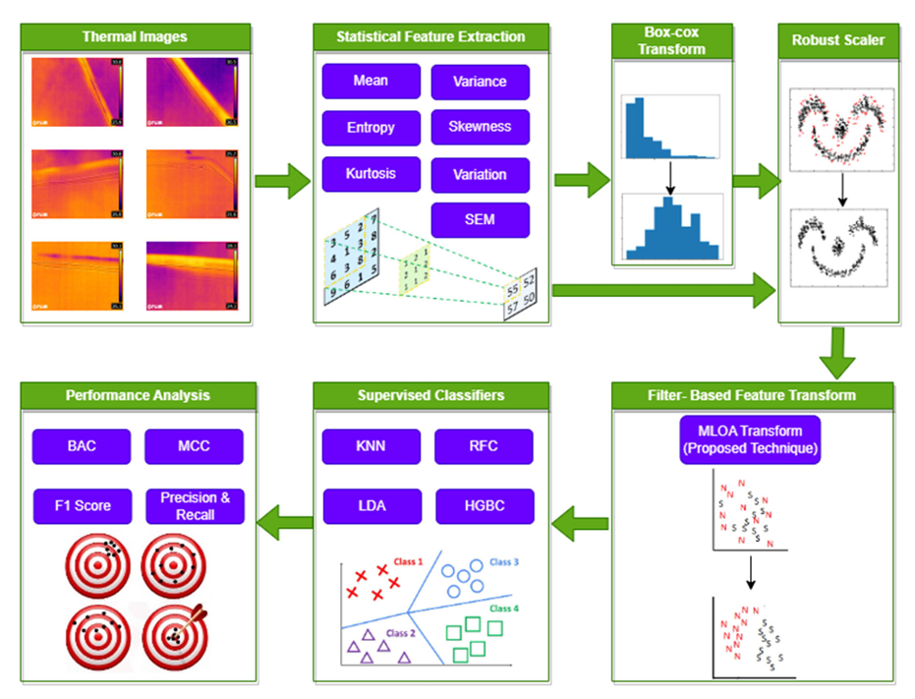
Work Flow:

Slide 11
Data Collection:
The data sets for this project were obtained from kaggle.
The collected data consists of :
Images of a leaf containing Blast, Bacterial leaf blight, hispa, leaf folder,
leafspot and healthy leafs.

Slide 12
Data Processing:
Removed corrupted or irrelavent images from the datasets.
Data processing is done by using numpy,tensorflow,matplotlib
libraries.
Thermal images in the datasets were read using load_img,imshow().
Statistical feature extraction was done by help of numpy library.

Slide 13
Exploratory Data Analysis:
Exploratory data analysis(EDA) is an open-ended process where we calculate statistics and make plots to find trends , anamolies, patterns or relationships within the data. The goal of EDA is to learn about the data.
Visualization of the data is performed by using matplotlib.pyplot library.This library includes a variety of plots to show how the data variables relate to one another.
Statistical feature extraction includes finding mean, variance, entropy, skewness, kurtosis, variation, SEM.
This is done using numpy libraries.

Slide 14
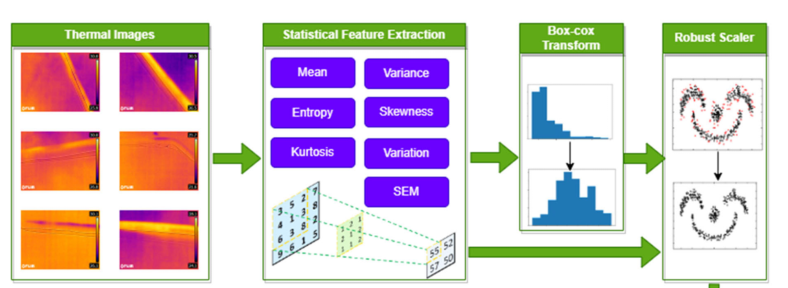
(Continued..)

Slide 15
Transformation:
Transformation of statistical measures are done by Box-Cox powertransformation.
This transform is used to convert the non-normal feature into feature that follows normal distribution.
The resulting histograms illustrate the impact of the Box-Cox transformation on the data distribution. The transformation aims to make the transformed data more symmetric and closer to a normal distribution.
The following contains comparison of statistical measures before and after Box-Cox transformation.

Slide 16
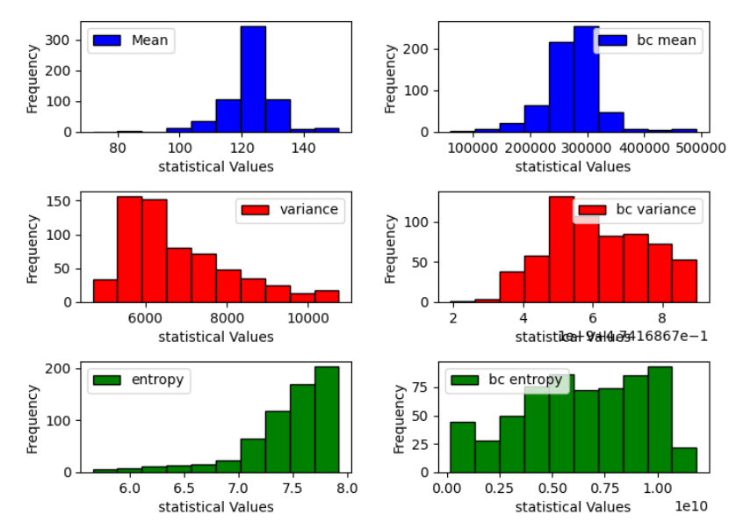
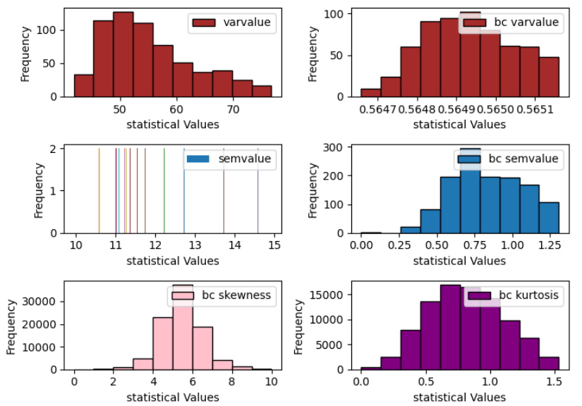
Statistical measures before & after transformation:

Slide 17
Scaling:
The extracted features from box-cox transformation passed to the Robust Scalar.
It is used to convert features to a common scale.
Robust scaler is mainly preferred because of its ability to treat outliers.
It is particularly useful when the dataset contains extreme values.
The resulting histograms illustrate the impact of robust scaling, which reduces the influence of outliers on the scaled data distribution.
The following contains comparison of statistical measures before and after Robust Scaling.

Slide 18
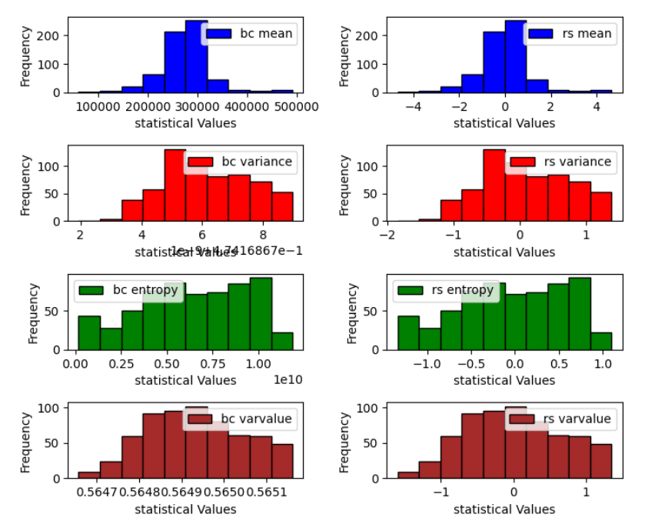
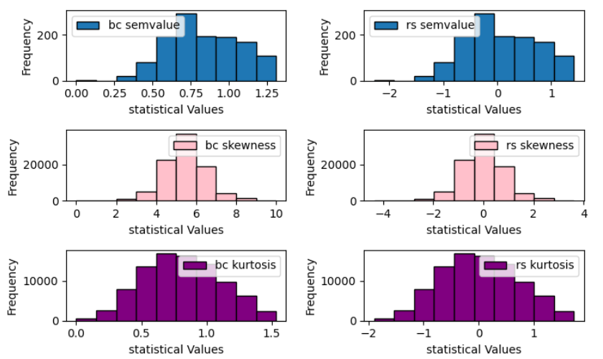
Statistical measures before & after scaling:

Slide 19
Work Flow:
Until now:
Data set has been collected and pre-processed.
Statistical measures are calculated for the images.
Box-cox transform has been done in order to get normal distribution.
Robust Scaling has been done in order to standardize data.
Further:
Filter-based Feature transformation has to be done using MLOA transform.
Supervised classifiers have to be used to predict the class for the input.
Performance analysis has to be computed from the output of classifiers.

Slide 20
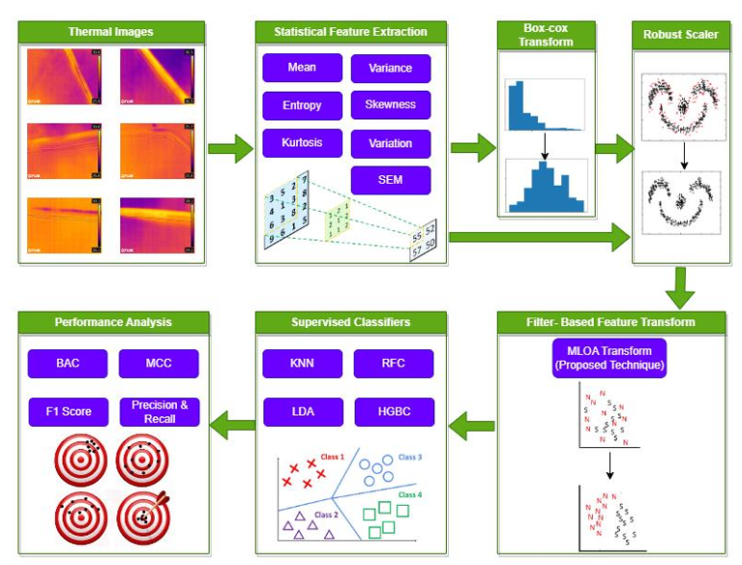
Obtain 14 statistical features, i.e., 7(before trans.) + 7(after trans.) and give these features as input to the models and record the accuracy.

Slide 21




Implementation of lemurs optimization algorithm
Firstly generate initial population matrix of s*d where s is no.of lemurs and d is no.of decision variables
Generate this matrix using the following formula, where ubj is upper bound of j and lbj is lower bound of j and rand() is random number.
For every iteration update the population matrix using following formula, where gbestj is global best lemur and nbestj is nearest best lemur and FRR is free risk rate.
For calculating free risk rate use the following formula,where HRR is high risk rate, LRR is low risk rate, and these two values are predefined and Crnt_iter is current iteration and max_iter maximum iteration.
And give the population matrix of last iteration as input to the models and obtain the accuracy.

Slide 22





Implementation of modified lemurs optimization algorithm
Extract the 14 statistical features from the thermal image.
Initialize the position of Lemurs with the extracted statistical features as L.
Initialize the parameters of MLOA: 𝐿𝑚𝑎𝑥 = max (𝐿1,𝐿2,….,𝐿14), L 𝑚𝑖𝑛 = min (𝐿1,𝐿2,….,𝐿14), Max_Iter = 12, 𝐹𝑅𝑅𝑖𝑛𝑖𝑡𝑖𝑎𝑙 = 0.5, Lrate = 0.5
Compute the fitness value of each Lemur using following equation. F(Li) = Var(Li-1, Li, Li+1)
Based on the fitness value, find the gbest and nbest
Update the position of all the Lemurs using equations using following equation.
Where r1 is,
Identify the Lemur with lowest fitness value as Worst Lemur and update its position using following equation
Compute the Loss function and update the weight parameter FRR using following equations

Slide 23

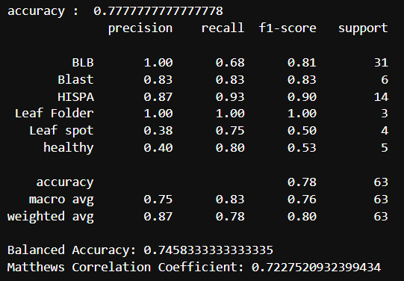
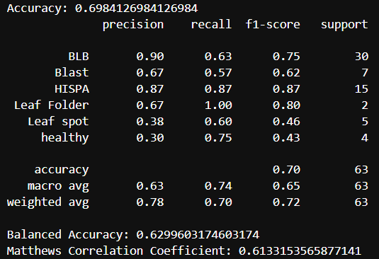
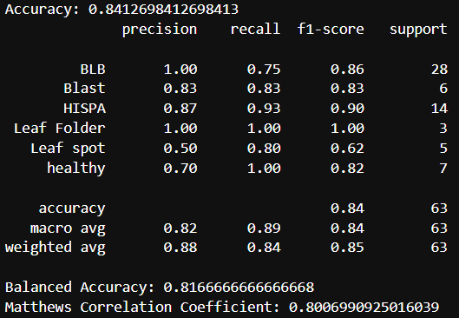
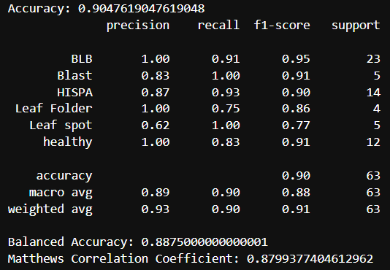
Classification report of all classifiers before any optimization
Fig 1a. KNN Model classification report
Fig 1b. LDA Model classification report
Fig 1c. RFC Model classification report
Fig 1d. HGBC Model classification report

Slide 24
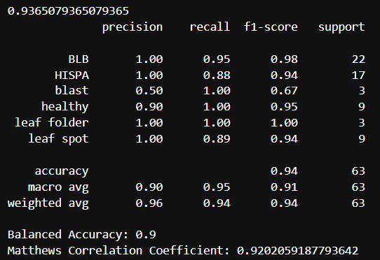
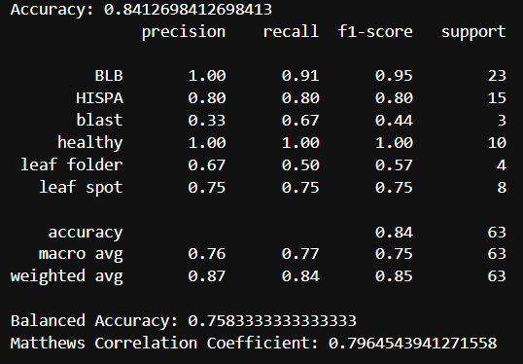
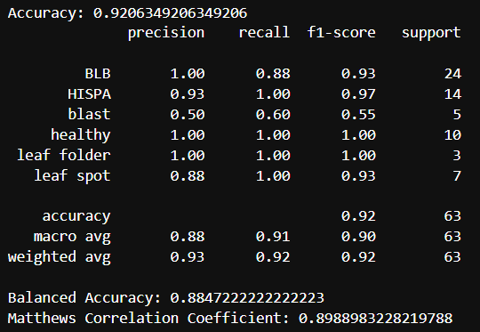
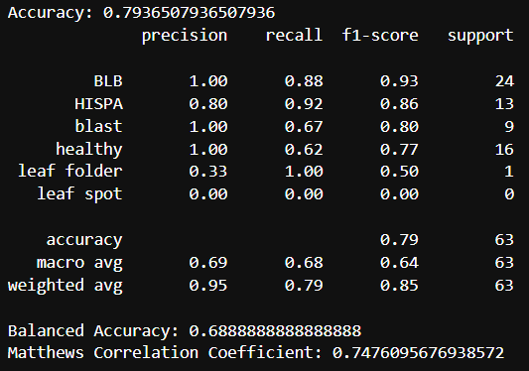
Classification report of all classifiers after LOA optimization
Fig 1a. KNN-LOA Model classification report
Fig 1b. LDA-LOA Model classification report
Fig 1c. RFC-LOA Model classification report
Fig 1d. HGBC-LOA Model classification report

Slide 25
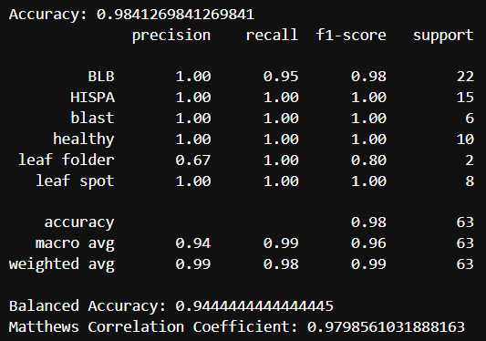
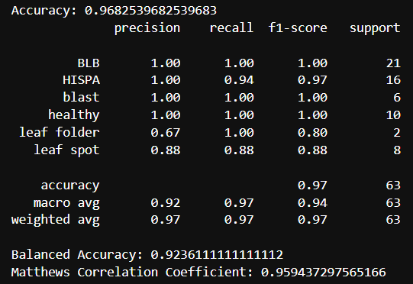
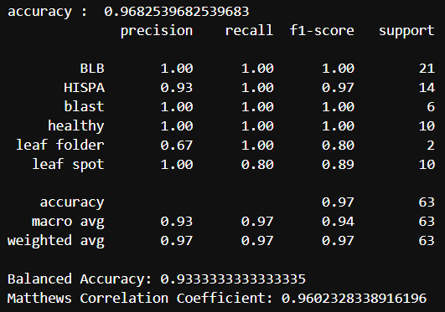
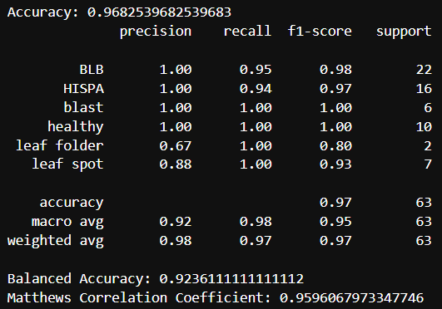
Classification report of all classifiers after MLOA optimization
Fig 1a. KNN-MLOA Model classification report
Fig 1b. LDA-MLOA Model classification report
Fig 1c. RFC-MLOA Model classification report
Fig 1d. HGBC-MLOA Model classification report

Slide 26
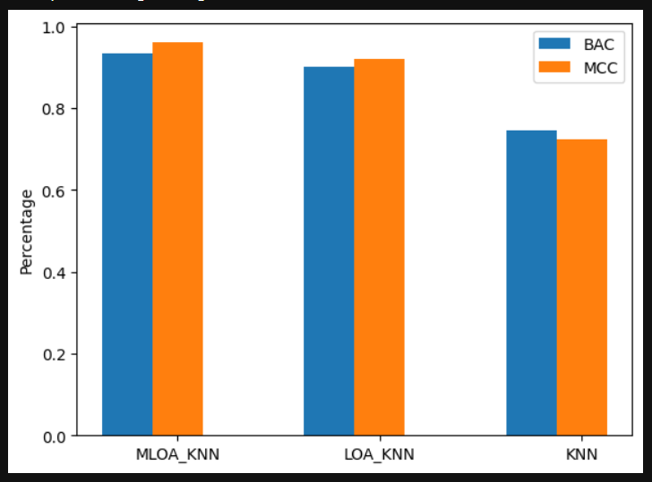
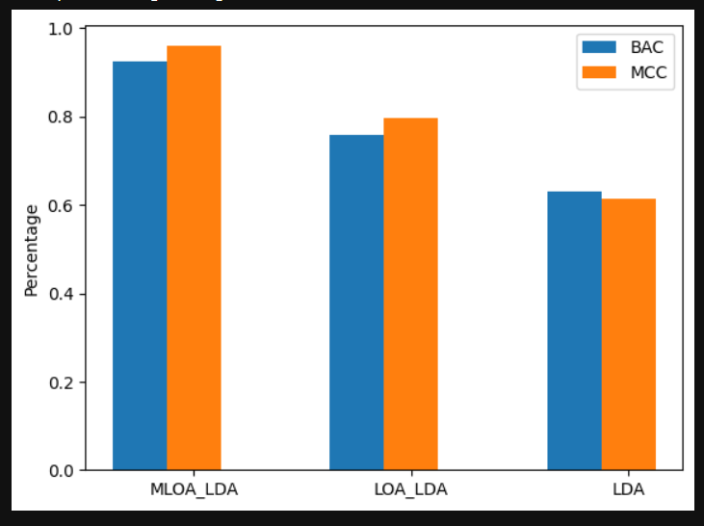
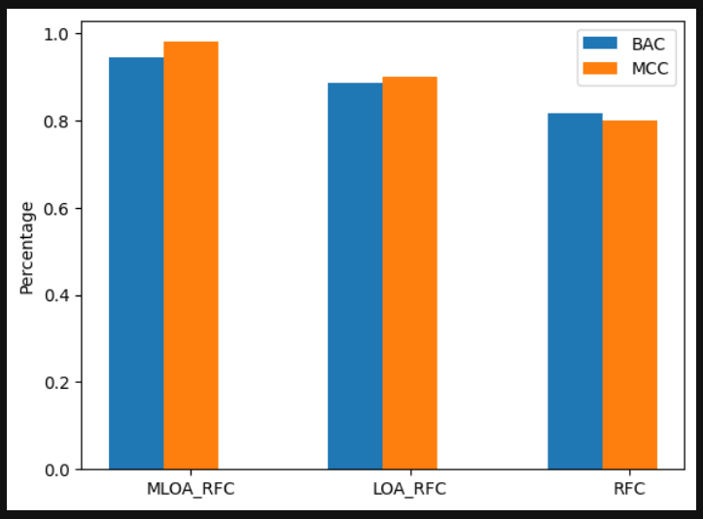
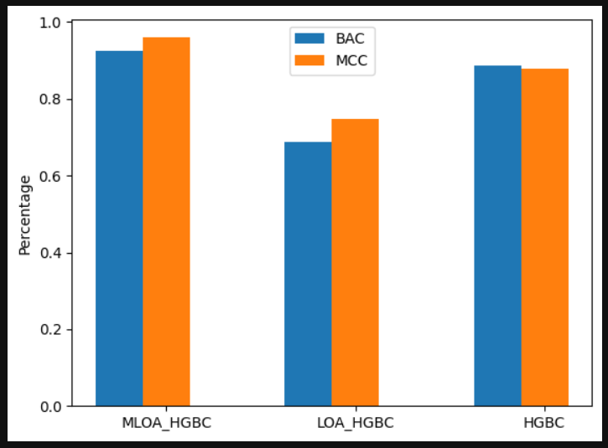
Grouped bar plots of BAC,MCC of all classifiers after MLOA optimization

Slide 27
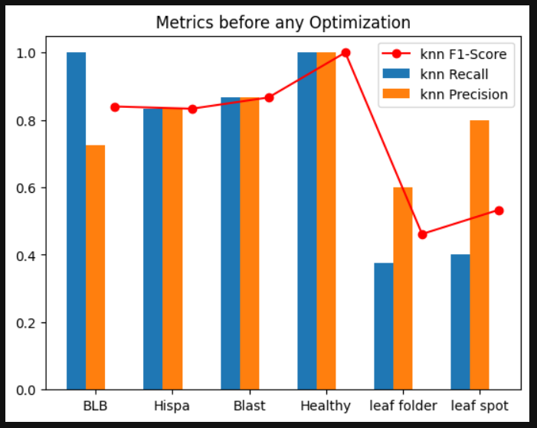
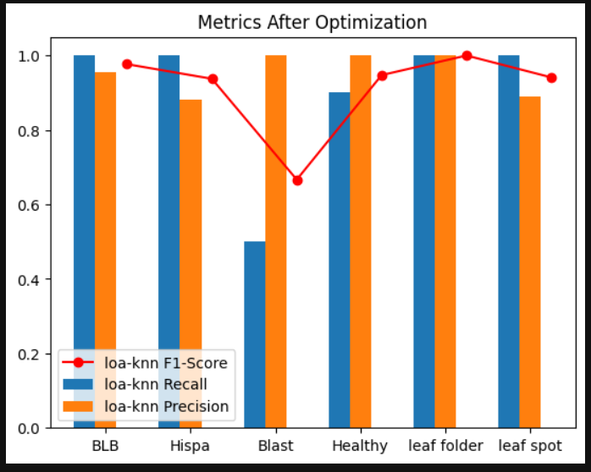
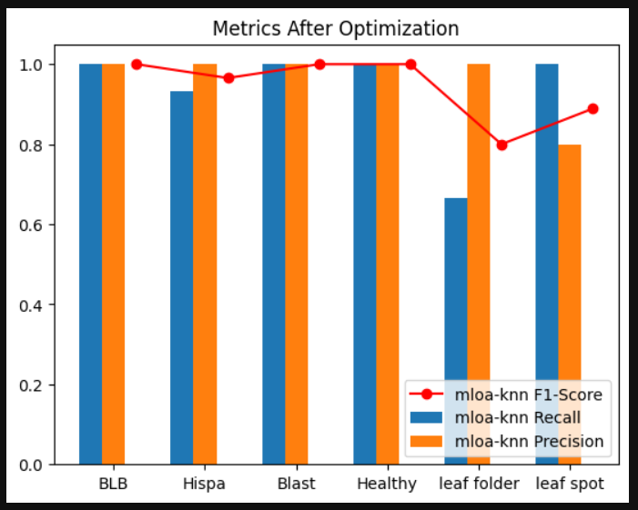
Metrics before and after optimization
Fig 5a.Metrics before any optimization
Fig 5a.Metrics after LOA optimization
Fig 5a.Metrics after MLOA optimization

Slide 28
Dataset
Dataset url: https://www.kaggle.com/datasets/sujaradha/thermal-images-diseased-healthy-leaves-paddy

Slide 29
Conclusion
The focus on early identification of paddy leaf diseases using thermal image cameras is a promising approach to mitigate such loses. The analysis involves 636 thermal images, from which statistical and Box-Cox transformed features are extracted. Four machine learning techniques, namely K-Nearest Neighbor (KNN), Random Forest Classifier, Linear Discriminant Analysis, and Histogram Gradient Boosting Classifiers, are employed and evaluated. Among them, KNN stands out with a balanced accuracy of 90%. This indicates a significant advancement in early detection capabilities, which could potentially lead to a substantial reduction in the global yield losses caused by paddy diseases.

Slide 30
References:
S. A. Noor, N. Anitha, and P. Sreenivasulu, ‘‘Identification of fungal diseases in paddy fields using image processing techniques,’’ Int. J. Adv. Res., Ideas Innov. Technol., vol. 4, no. 3, pp. 777–784, 2018.
M.S.Lydia,I.Aulia,I.Jaya,D.S.Hanafiah,andR.H.Lubis,‘‘Preliminary study for identifying rice plant disease based on thermal images,’’ J. Phys., Conf. Ser., vol. 1566, no. 1, Jun. 2020, Art. no. 012016.
K.W.HtunandC.S.Htwe,‘‘Development of paddy diseased leaf classifi cation system using modified color conversion,’’ Int. J. Softw. Hardw. Res. Eng., vol. 6, no. 8, pp. 1–12, 2018.
Z. Zhang, ‘‘Introduction to machine learning: K-nearest neighbors,’’ Ann. Transl. Med., vol. 4, no. 11, p. 218, Jun. 2016.
S. Mirjalili, ‘‘SCA: A sine cosine algorithm for solving optimization problems,’’ Knowl.-Based Syst., vol. 96, pp. 120–133, Mar. 2016.

Slide 31


